Slide 1
Oedogonium: structure and growth
Dr. Jahid Ali Malik

Slide 2
Classification
Kingdom: Plantae
Class: Chlorophyceae
Order: Oedogoniales
Family: Oedogoniaceae
Genus: Oedogonium

Slide 3
Occurance
Oedogonium is the most common genus of the order Oedogoniales.
It is a freshwater filamentous alga with more than 400 species.
Usually present in permanent water bodies of water, such as ponds, lakes and shallow tanks.
The filaments are attached to rocks, logs, etc. or are epiphytic on aquatic plants and other algae.
Some species (e.g.. O. terrestris, O. randhawe) are terrestrial, growing on moist soils.
The genus is represented in India by more than 200 species, the common ones being O. areolatum, O. cardiacum, O. aster and O. elegans. O. armigerum,

Slide 4
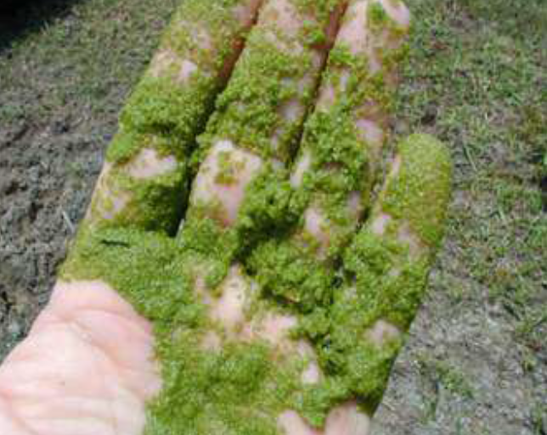
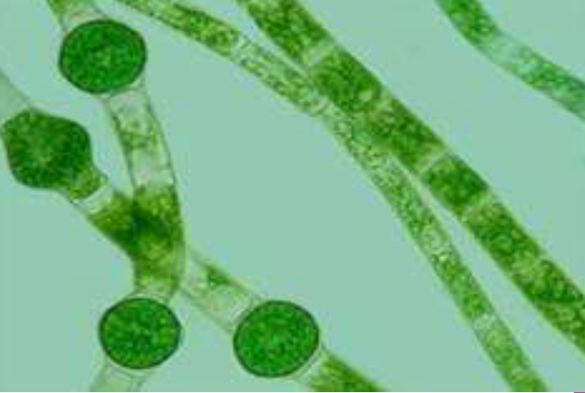
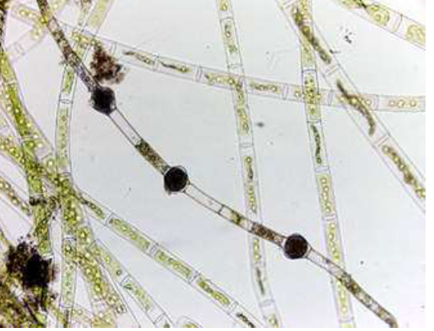
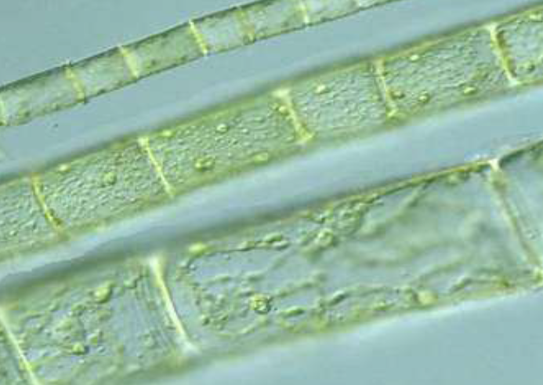

Slide 5
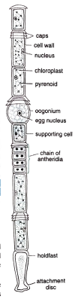
Thallus Structure
The thallus of Oedogonium is multicellular and filamentous. The filaments are uniseriate and unbranched. The cells of the filament can be differentiated into following three types:
1. Basal cell.
2. Apical cell.
3. Intercalary cell.

Slide 6
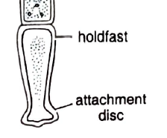
Basal cell
It is the lowermost cell of the filament; it is long, gradually
narrowed towards the basal end where it expands to form
simple, disc-like, multi-lobed or finger-shaped projections.
The basal cell is generally colourless and performs the
function of fixation to the substratum and is called holdfast.

Slide 7
2. Apical cell
It is upper most cell of the filament.
The cell is usually rounded towards the apical side.
Apical cell is green in colour.
3. Intercalary cell
All the cells between basal and apical cells.
All are alike
These are longer than their breadth

Slide 8
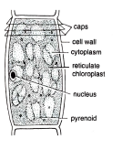
Cell Structure
The cell has a thick and rigid cell wall
It is differentiated into an :-
outer chitin,
a middle pectin
and an inner cellulose layer
Inner to Cell wall, cell membrane is present which encloses the protoplast.
The centre of the cell is occupied by a large vacuole.
The protoplast foms a thin layer in between the central vacuole and the cell membrane.
The chloroplast is single, large reticulate type.

Slide 9
Many pyrenoids are present at the intersections of the chloroplast reticulum.
The cells are uninucleate.
A characteristic feature of Oedogonium is the presence of distinctive ring-like scar at the distal end of some cells.
The band. formed at the time of cell division, is called apical cap, and the cell with apical cap is known as cap cell.

Slide 10
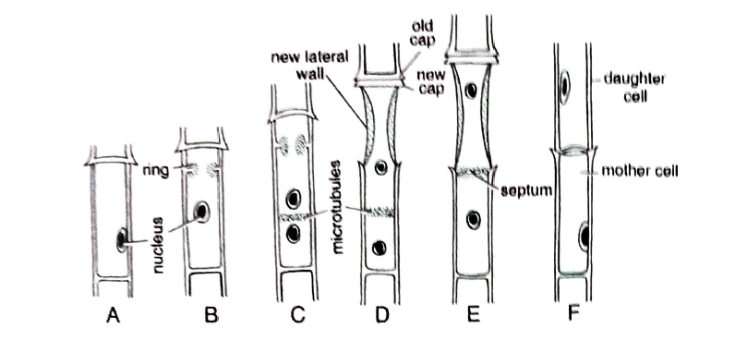
Growth and Cell Division
Growth in Oedogonium takes place as a result of the divisions in the intercalary cells.
Sequential stages of cell division

Slide 11
Thank You

